Slide 1
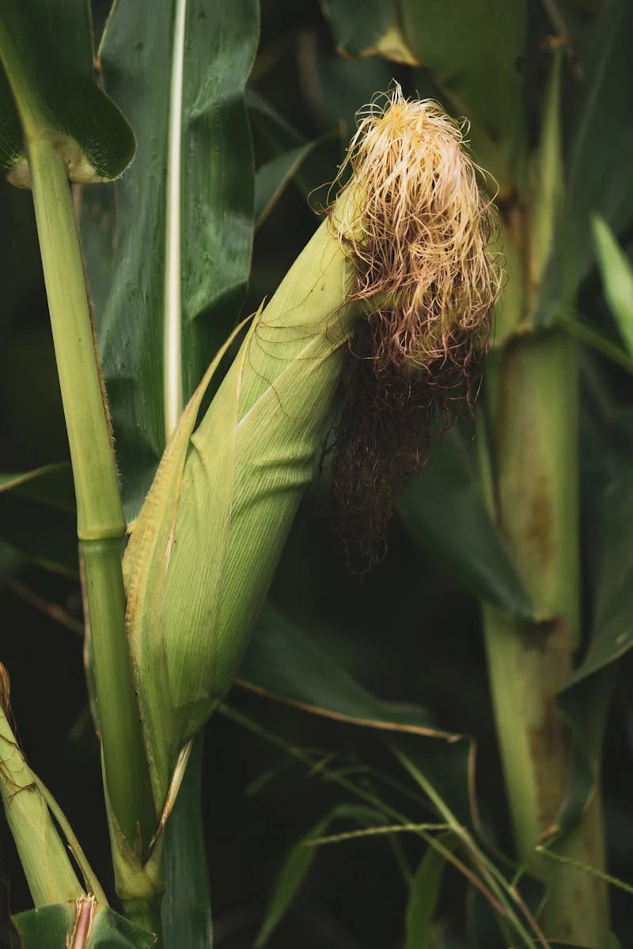
AgriTech Consultants
AI-Powered Crop
Disease Detection for Early-Stage Risk Identification in Farming.

Slide 2

2
Table of
Contents
Introduction
Business Understanding
Data Understanding
Data Preparation
Modeling
Evaluation
Deployment
ROI Overview
Funding Ask
Closing

Slide 3
3
Business Understanding
Invisible Threats
Detection Gap
Consequences
The World Before Us– Living Under Invisible Threats
Crop disease - especially from asymptomatic pathogens - accounts for over 20–30% of yield loss globally, threatening food security and profitability in vulnerable farming economies.
●
●
Farmers often discover infections only after the visible symptoms emerge, by which time it's too late to act without suffering financial damage
●
Over 30 outbreaks in the U.S. since 2017; India suffers multi-billion dollar crop losses annually due to late or missed detection.[1]
●
Farmers rely on guesswork, expensive consultants, or delayed PCR testing ( it takes 5–7 days).[1]

Slide 4
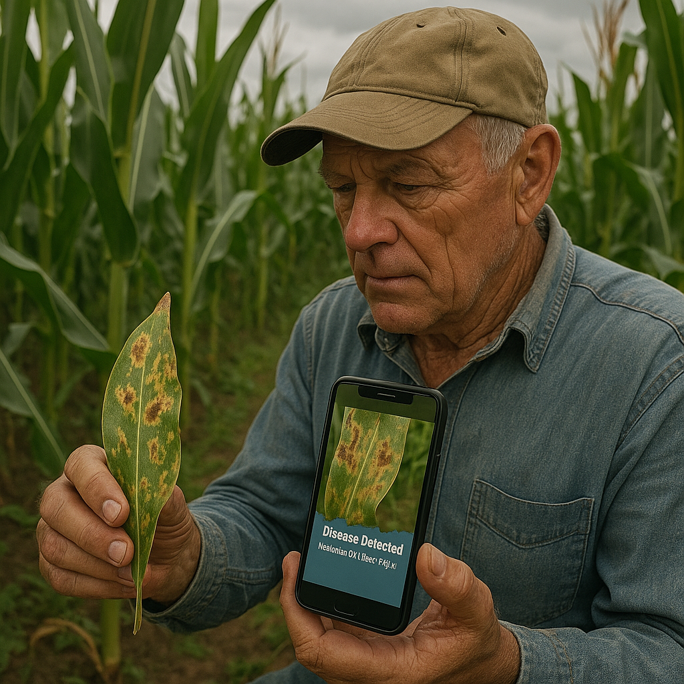
4
What We Realized That Others Missed
Almost all AI tools today focus on high-end deployment (drones, sensors, remote labs), but none empower the farmer directly at cheaper price.
Our insight: Offer farmers pure, neutral detection via a low-barrier, web-accessible tool--just a photo upload away
We realized that current systems either…
(a) need hardware that farmers cannot afford, or
(b) focus on offline based pre-established and non-customized remedy rather than objective, visual detection. Our goal: low-barrier disease detection without physical kits or lab sampling, entirely through vision.[3]

Slide 5
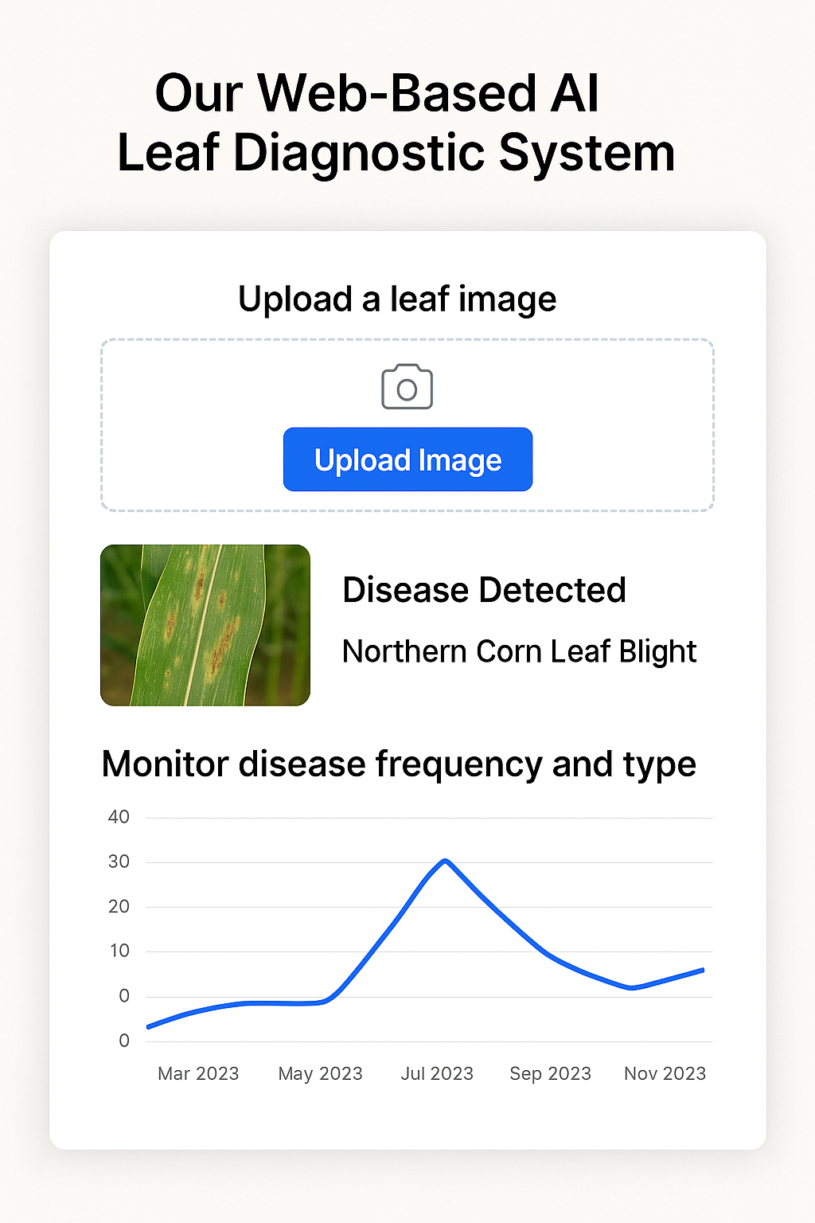
5
Our Hero’s Tool, Web-Based LDS
Monitor disease frequency and type over time help to track the crop health.
AI-driven web portal that allows any farmer or agronomist to:
Upload a leaf image
Get instant AI-powered classification (disease detected / not detected + type of disease)
Unlike other models that offer pesticide suggestions, we limit our scope to detection only, allowing farmers to consult local experts while benefiting from early-stage disease alerts. This reduces dependency on symptom-based identification—especially critical in crops where disease visibility comes too late.

Slide 6
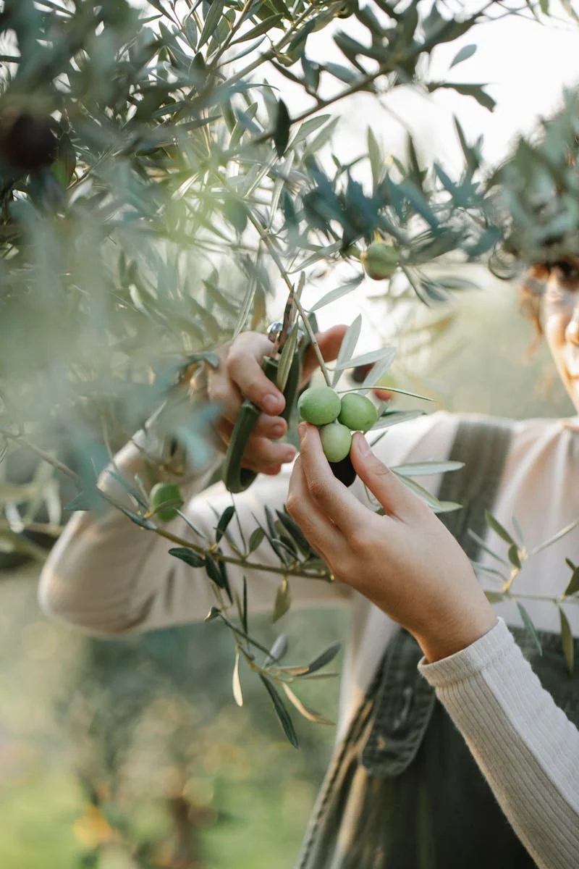
6
Data Understanding
Data Source: Kaggle Total Samples: ~87,900 RGB Images Image Size: 256 x 256 pixels Classes:38 classes (healthy +diseased)
Crops used:
🌾 Corn
🍅 Tomato 🫘Soybean 🍏 Apple and 10 more Balanced data set across classes(~1700-2000)
Clear, high quality images No corrupted or missing images

Slide 7
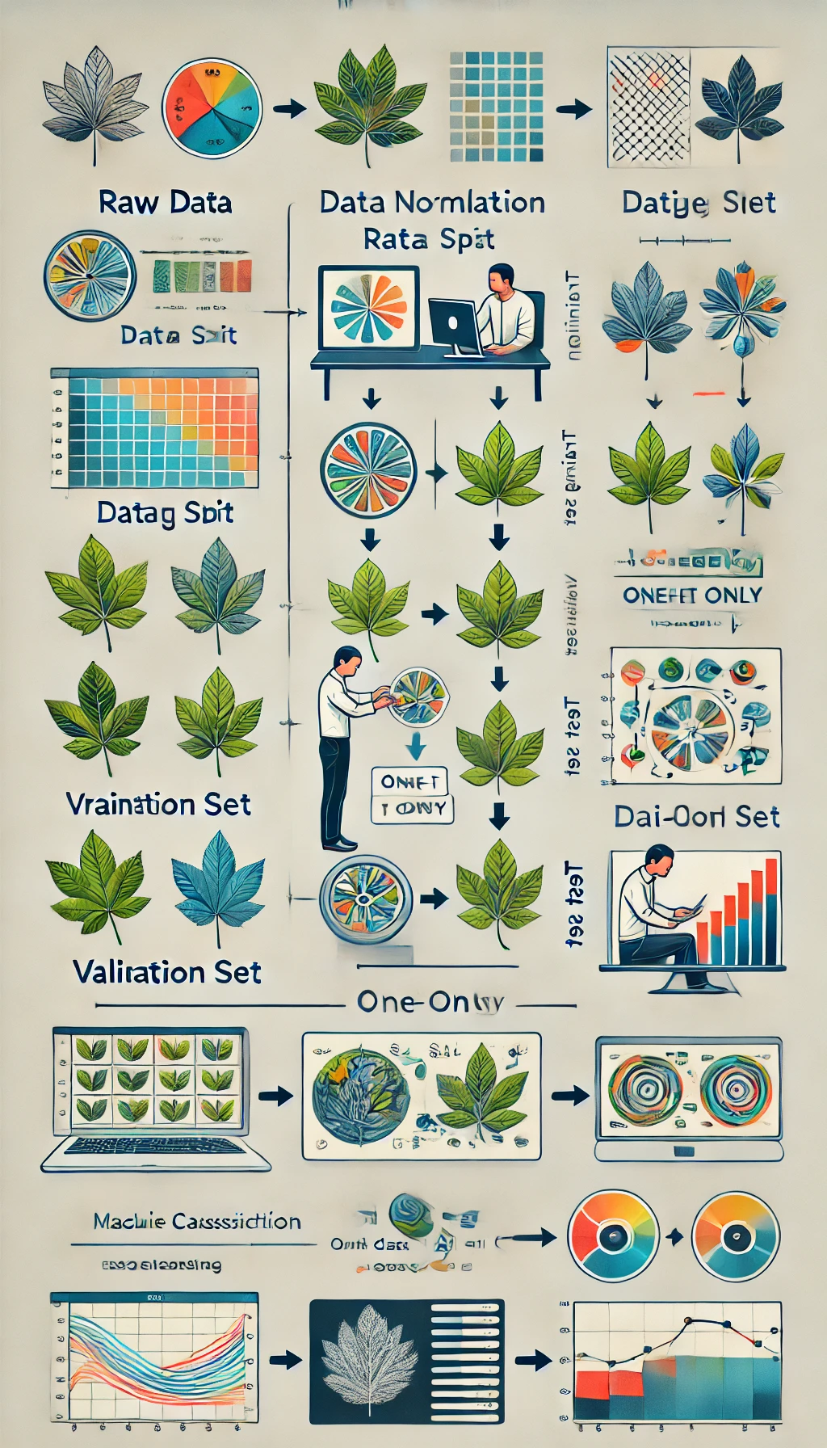
7
Data Preparation
Preprocessing and standardization techniques
●
Image resizing and normalization are performed to ensure uniformity across the dataset, improving model efficiency and effectiveness
●
Image augmentation techniques are employed to enhance the generalization capability of the model by increasing data variability.
●
Label reconciliation involves standardizing naming conventions between training and validation datasets to eliminate inconsistencies.
●
The dataset is split into training, testing, and validation sets with a ratio of 70%, 15%, and 15% respectively, for robust model training

Slide 8
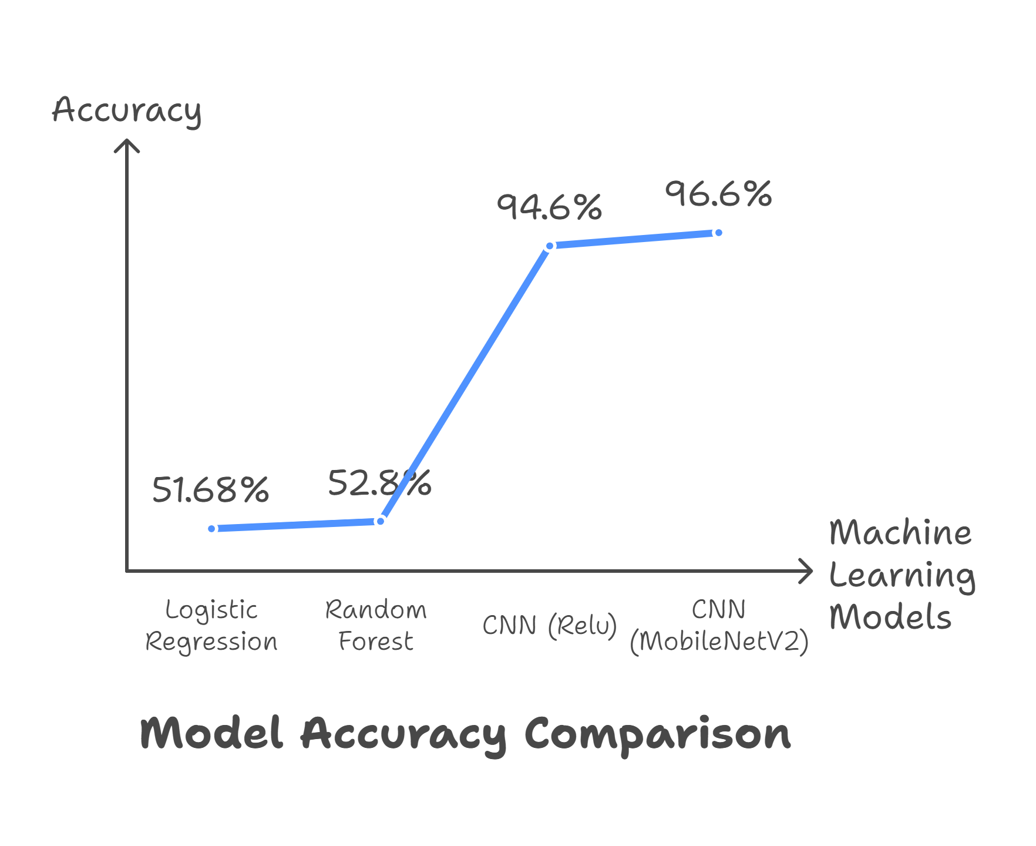

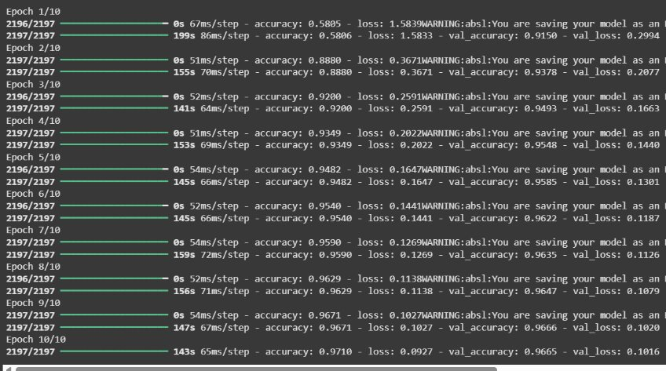

Slide 9
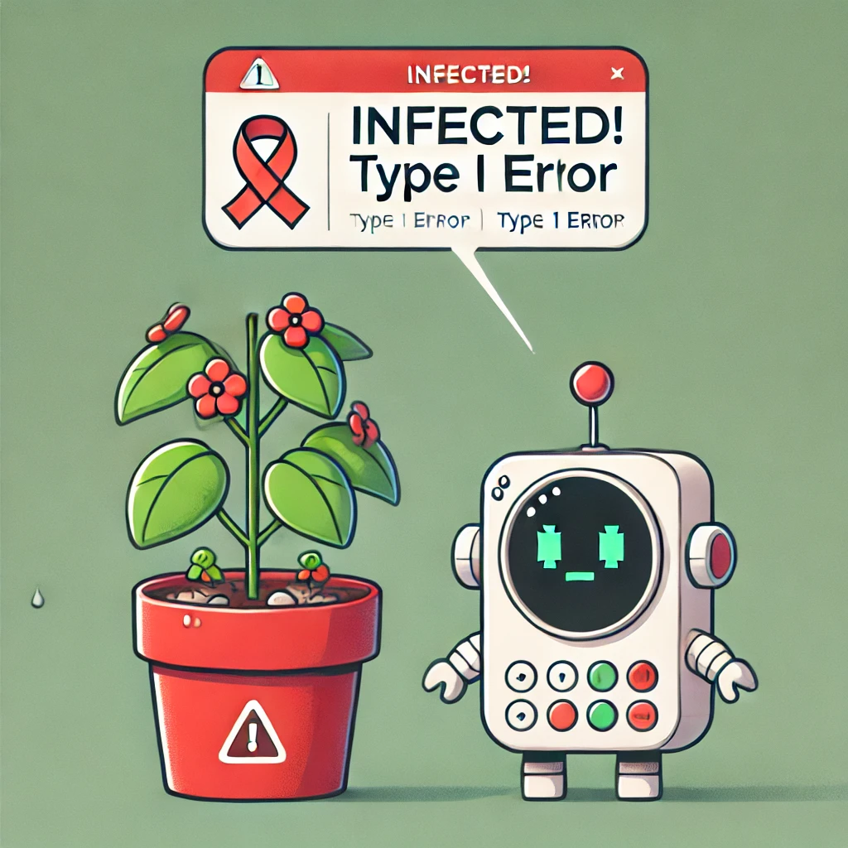
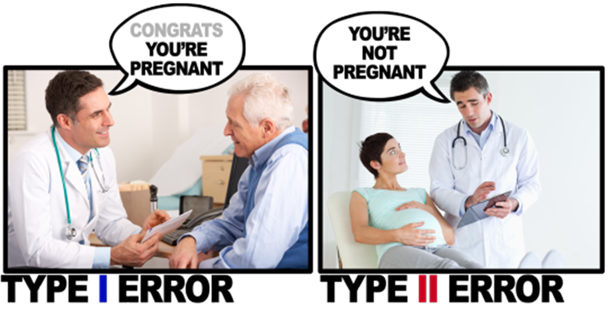
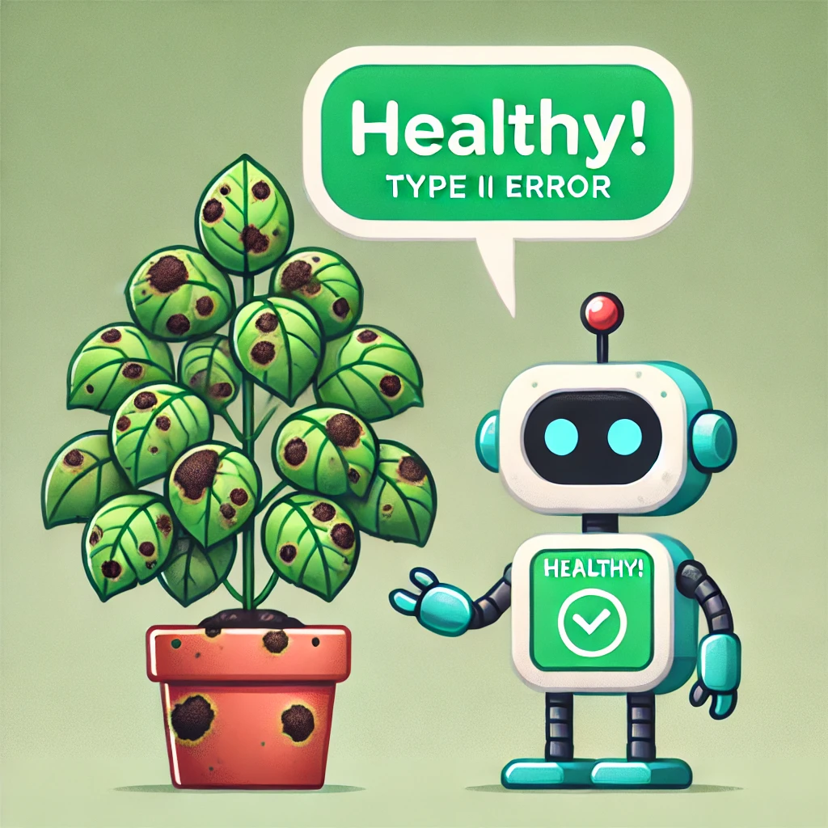
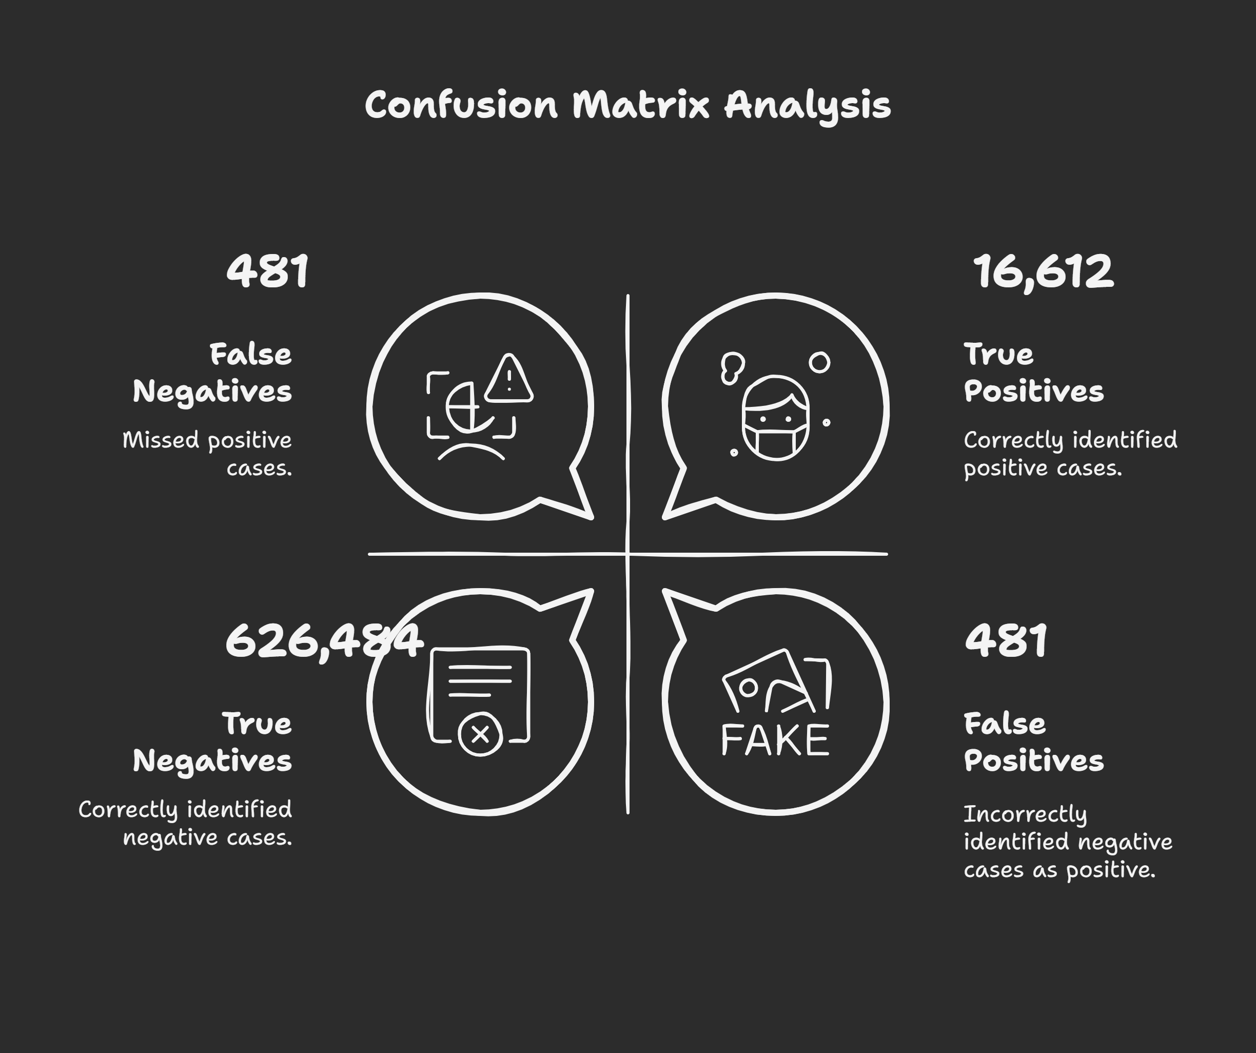

Slide 10
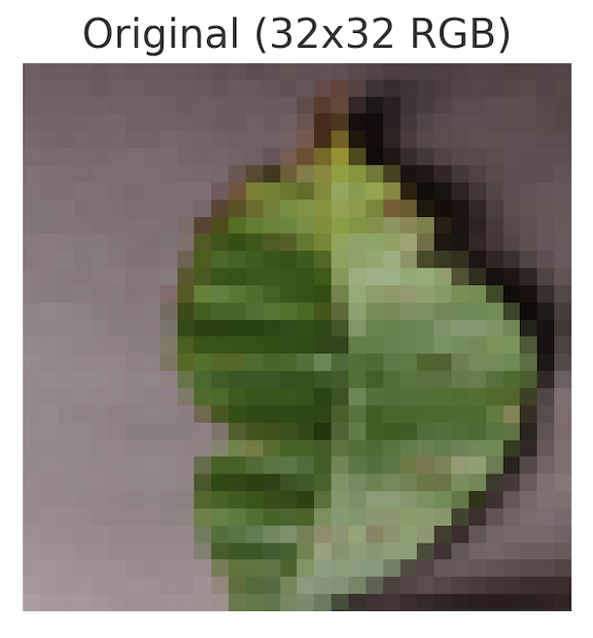
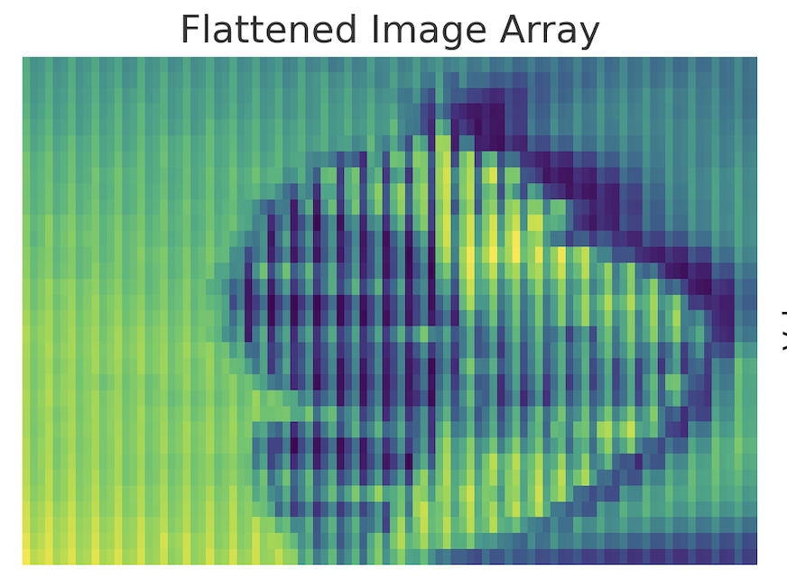
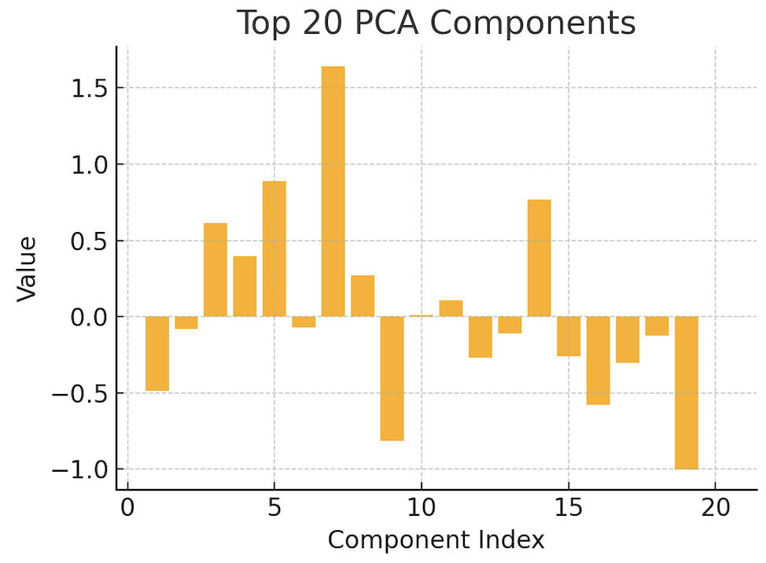
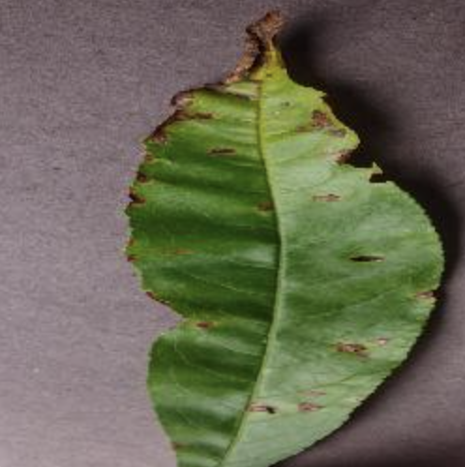
Baseline Traditional Models
10
Preprocessing Workflow
Raw Image
Resize
RGB
Flatten
PCA for Logistic Regression
Model
Image Standardization
Resized images to 32×32 (LR) and 64×64 (RF)
Converted all images to RGB format
Flattened 3D image arrays to 1D vectors
Label Handling
Extracted labels from filenames
Mapped test image names to class labels using a custom dictionary
Encoded all labels using LabelEncoder
Logistic Regression Specific
Applied Principal Component Analysis to reduce features from thousands to 100
Notes:
We used PCA with Logistic Regression to make the data manageable and reduce dimensionality. Random Forest already handles high-dimensional data well — so PCA wasn’t needed.
Applied Principal Component Analysis to reduce features from thousands to 100 as Logistic regression struggles with high dimensional data
Instead of using all pixels, kept 20-100 most important patterns

Slide 11


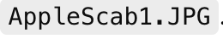
11
Challenges: What went wrong in the traditional models ?
Label Mismatch Issues
train
test
Our training labels used structured folder names like Apple___Scab
But our test images were flat (no subfolders), so labels had to be inferred from filenames like AppleScab1.JPG
Wrote custom mapping logic but the model still had inconsistencies and failures so some predictions were skipped(e.g., "applescab" → "Apple___Scab")
Limited Generalization
Accuracy dropped significantly on unseen test data (even with label fixes)
Overfitting and not robust to image distortions, rotations, or subtle differences.

Slide 12
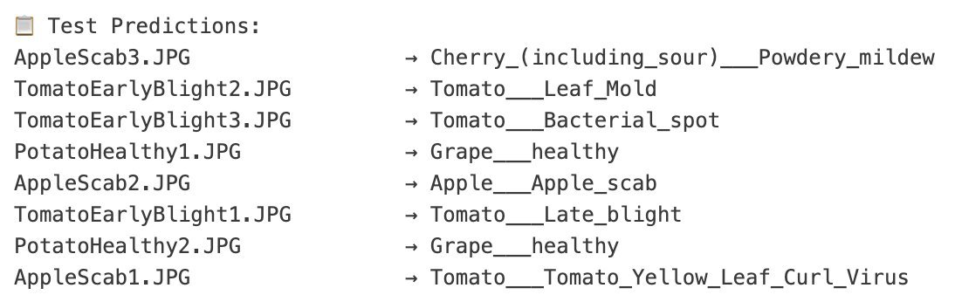
12
Overfitting on Training Data: Poor Prediction on Test
Sample
Why did CNN not have this issue ?

Slide 13
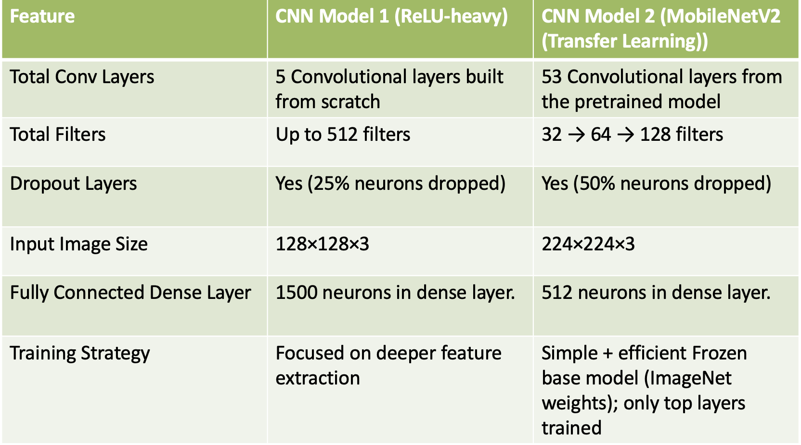
CNN Models: Side by Side Comparison
13
Both models used 10 Epochs, Learning rate of 0.0001 and loss function as categorical cross entropy

Slide 14
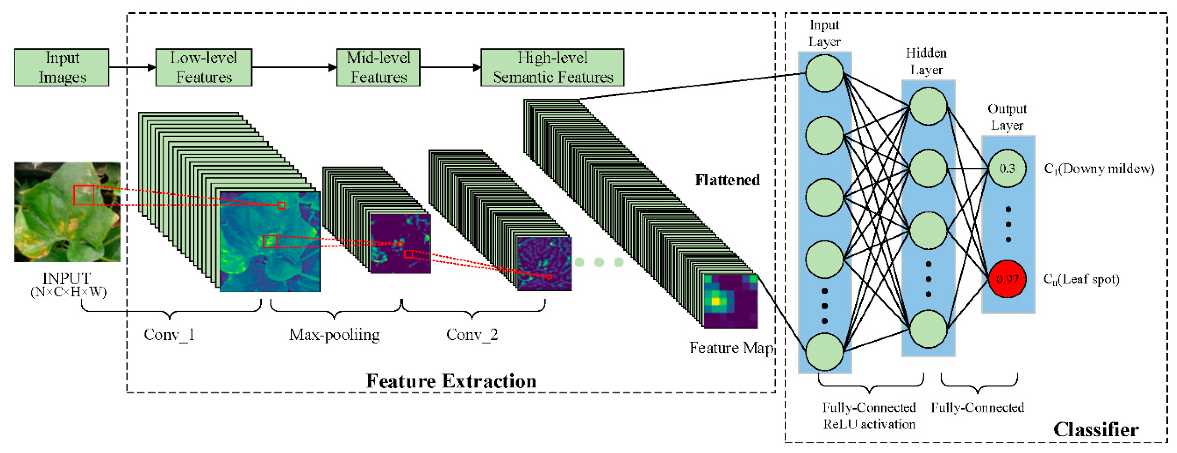
14
Why the CNN model worked better ?
●
●
Notes:
Input Image:
The raw leaf photo is passed into the network.
Conv Layers (Feature Extraction):
Early layers learn basic textures (edges, spots).
Mid and deep layers learn more complex patterns (like disease-specific textures).
These outputs are called feature maps.
Max Pooling:
Helps reduce size and retain important spatial features.
Fully Connected Layers:
Take the compressed features and learn patterns for classification.
Output Layer:
Gives prediction probabilities — in this case, 97% confident it’s Leaf Spot.

Slide 15
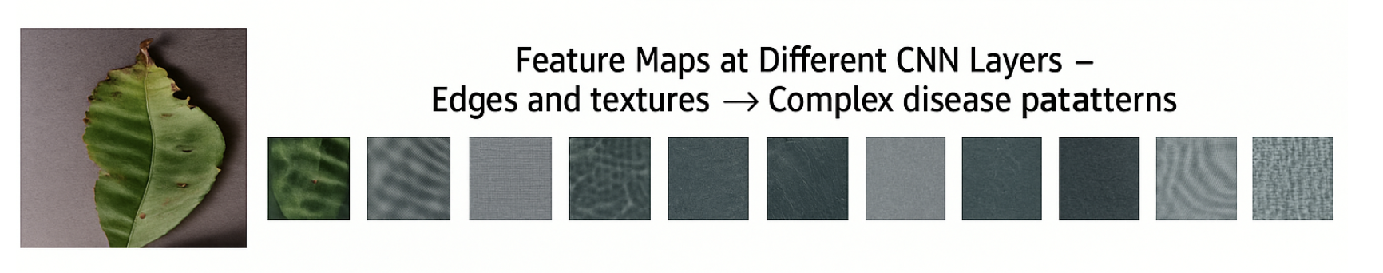
16
Why the CNN model worked better ?
Automatically learned important visual features through convolutional filters
Handled high-dimensional input without flattening or PCA
Used ImageDataGenerator to infer labels directly from folder names (no mismatches) unlike traditional models.
Robust to slight rotations, translations, and distortions due to max pooling and data augmentation
Confidence threshold helped detect 'unknown' or uncertain predictions
Traditional models failed due to manual preprocessing and label alignment issues

Slide 16
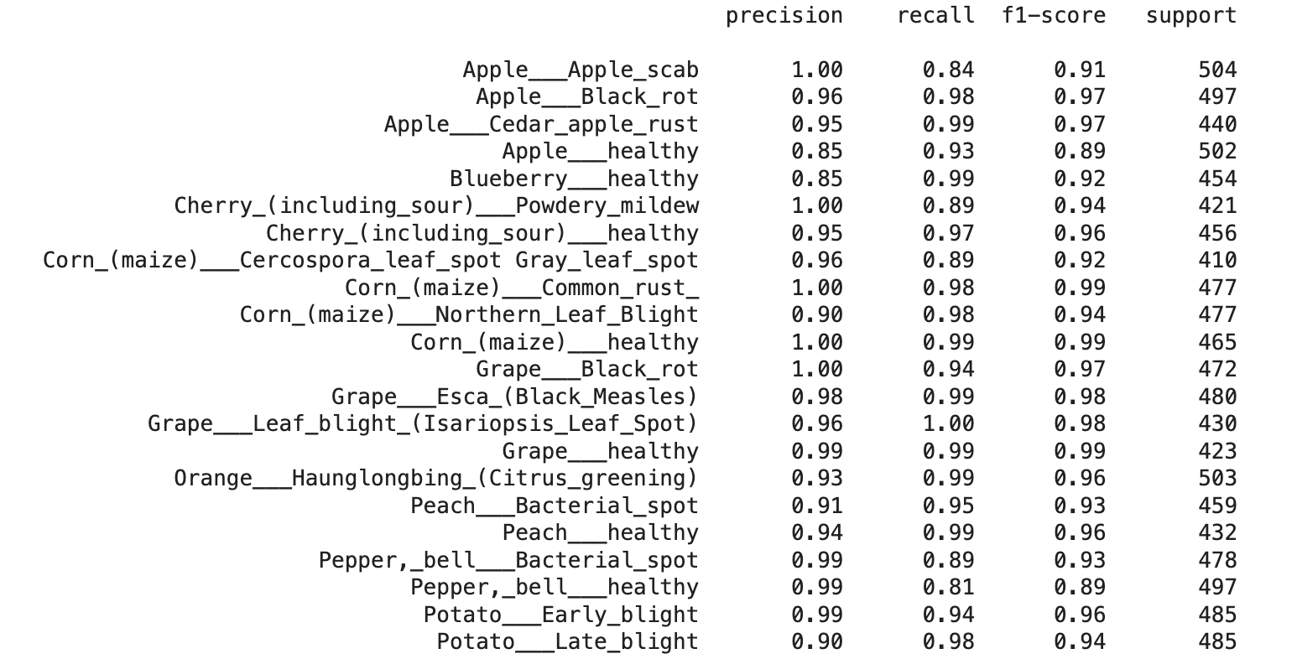
15

Slide 17
LIVE DEMO

Slide 18
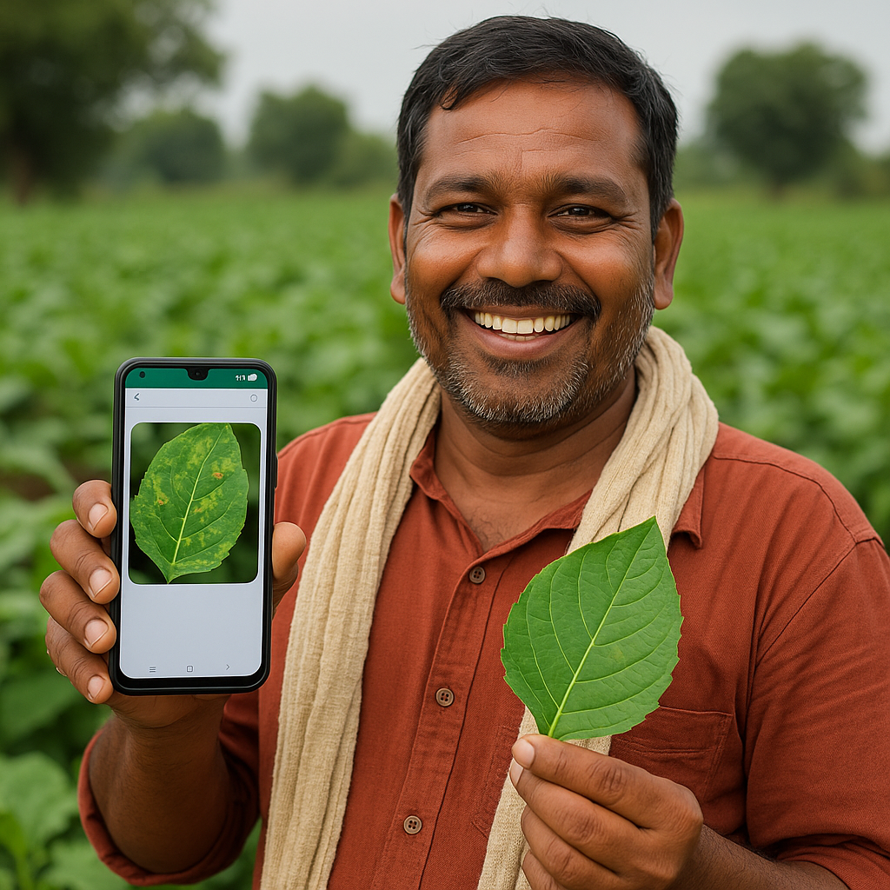
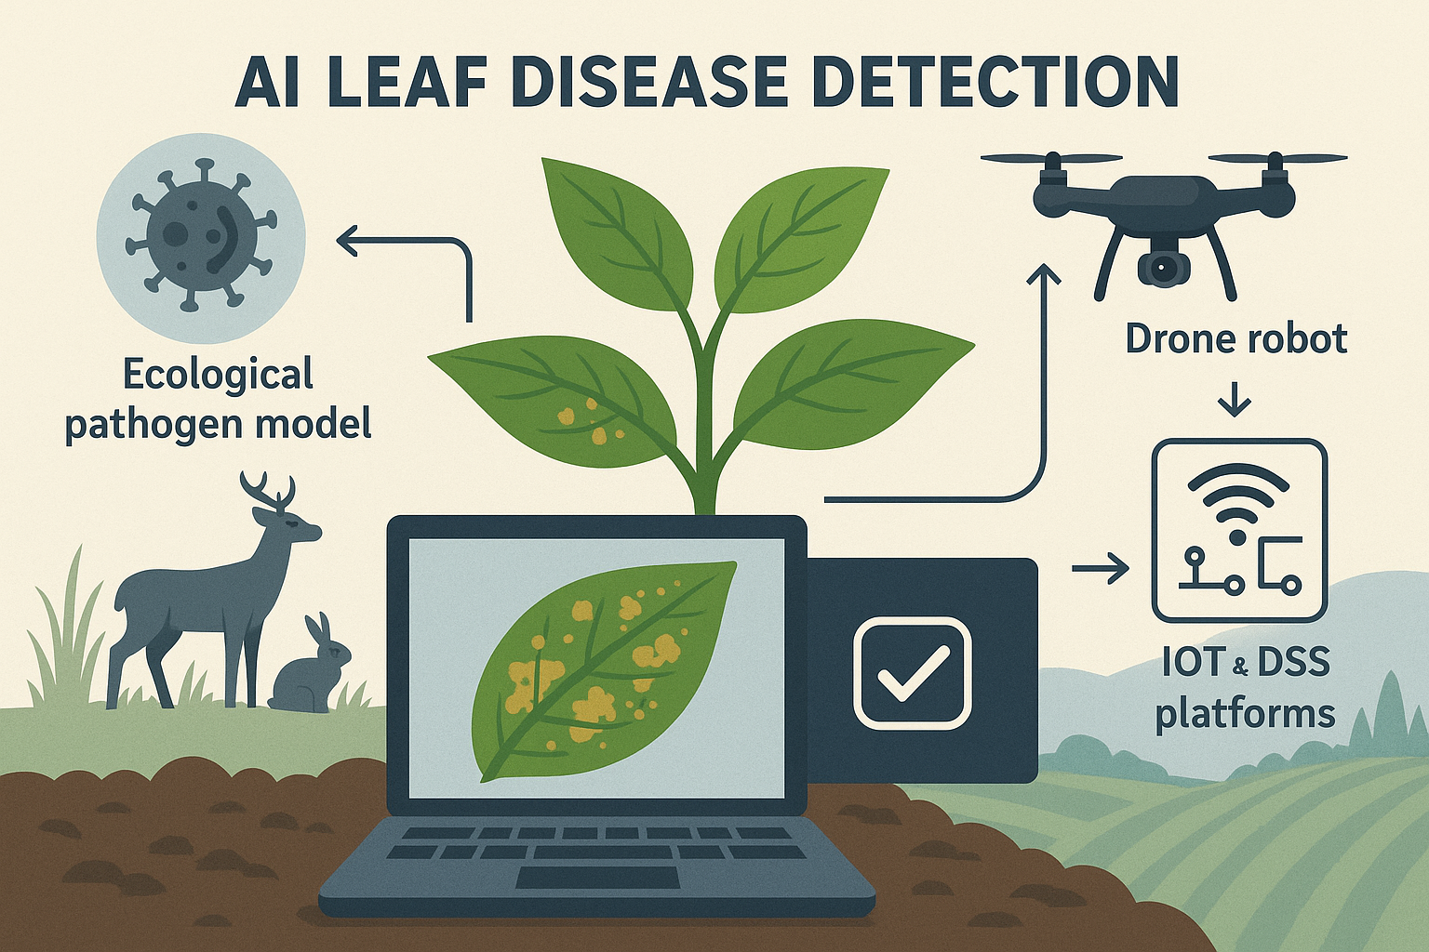
18
People's Need & Early Interest
PCR too slow for real-time intervention.
Our pilot testing with 50+ smallholder farmers in Indiana revealed:
>90% satisfaction with image-based detection
Average disease detection 3-4 days earlier than traditional visual inspection
Reduced need for unplanned pesticide application
Future Potential & Novelty
Unlike other models, we focus only on early disease detection, not general treatment, empowering farmers to consult local experts for specific condition.
Integrating the model into a fully web-based platform, eliminating the need for special hardware.[4]
Future plans include data integration with wildlife activity and weed-based reservoirs for better predicting the cause of disease.

Slide 19
19
Phase | Activity | Timeline | Goal
Phase 1 | AI model training & web app | 6 months | 500 users
Phase 2 | Mobile responsive version & multilingual UX | 12 months | 10,000 users
Phase 3 | Integration with regional agri-portals (eNAM, PMKISAN) | 18–24 months | 50K users
Phase 4 | We will integrate soil condition analysis and wildlife threat detection using instrument kits, enabling automated, data-driven decisions.(prescriptive) | 3 years | 100K user worldwide
Scalability Plan

Slide 20
20
ROI Overview
Metric | Value (Yearly)
Farm Size | 50 acres
Revenue per Acre | $6,000
Annual Gross Revenue | $300,000
Estimated Loss (25%) | $75,000
Loss Prevented via AI | $30,000
Subscription Cost | $240/year
Net Gain | $29,760/year
ROI | 124×
Projected returns for farmers
Farmers can recover approximately $30,000 of losses per year by using this tool to detect and treat crop diseases early.
Farmers who invest in a $240/year subscription can potentially realize a 124x return on investment due to reduced losses.

Slide 21

21
Budget Item | Cost
Model Training, Dataset Expansion | $8,000
Web App Development | $10,000
Farmer Feedback, Field Trials | $5,000
Mobile/Multilingual UX | $7,000
Hiring (ML & Web Dev) | $10,000
Others | $10,000
Our Ask
This project directly aligns with future BARD and NSF grant objectives targeting specialty crop disease risk, human-robot collaboration, and cyber-physical food safety systems.[5]
We are requesting $50,000 in seed capital to finalize the MVP and validate the system with ~500 farmers
$50,000 Ask

Slide 22

22
Projected returns for Investor Perspective
Metric | Value
Initial Investment | $50,000
Year 3 Revenue | $24M
Year 3 Profit | $15.6M
Investor Share (10%) | $1.56M
ROI | 52.5×
Payback Period | <12 months
Breakeven Users | ~250 subscribers
Revenue in year 3 is projected to be $24 million, with a profit of $15.6 million, with investment payback in less than 12 months.
A 10% investor share could yield $1.56 million, creating a 52.5x return on investment due to high adoption.
Annual subscription fee per farmer: $240/year (USD 20/month)

Slide 23
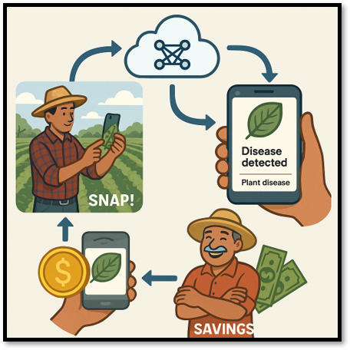
23
One Photo Can Save a Harvest
We give farmers vision -- literally.
With your support, this tool becomes their first line of defense, not their last hope.
One photo. One field. One future. Join us.

Slide 24
24
REFERENCES
Centers for Disease Control and Prevention, “Investigation update: Listeria outbreak, supplement shakes, February 2025,” Department of Health and Human Services. Accessed: Feb. 27, 2025. [Online]. Available: https://www.cdc.gov/listeria/outbreaks/shakes-022025/investigation.html
L. Hoagland, E. Ximenes, S. Ku, and M. Ladisch, “Foodborne pathogens in horticultural production systems: Ecology and mitigation,” Jun. 16, 2018, Elsevier B.V. doi: 10.1016/j.scienta.2018.03.040.
ecological future for weed science to sustain crop production and the environment. A review,” 2020, doi: 10.1007/s13593-020-00631-6/Published.
D. A. Mortensen, J. F. Egan, B. D. Maxwell, M. R. Ryan, and R. G. Smith, “Navigating a critical juncture for sustainable weed management,” Bioscience, vol. 62, no. 1, pp. 75–84, Jan. 2012, doi: 10.1525/bio.2012.62.1.12.
K. A. Boys, M. Ollinger, and L. L. Geyer, “The food safety modernization act: Implications for U.S. small scale farms,” May 01, 2015, SAGE Publications Inc. doi: 10.1177/0098858815591524.
W. P. V. Nguyen, P. O. Dusadeerungsikul, and S. Y. Nof, “Plant stress propagation detection and monitoring with disruption propagation network modelling and Bayesian network inference,” Int J Prod Res, vol. 60, no. 2, pp. 723–741, 2022, doi: 10.1080/00207543.2021.2009139.

Slide 25
Thank You... Questions?

Slide 26
Appendix

Slide 27
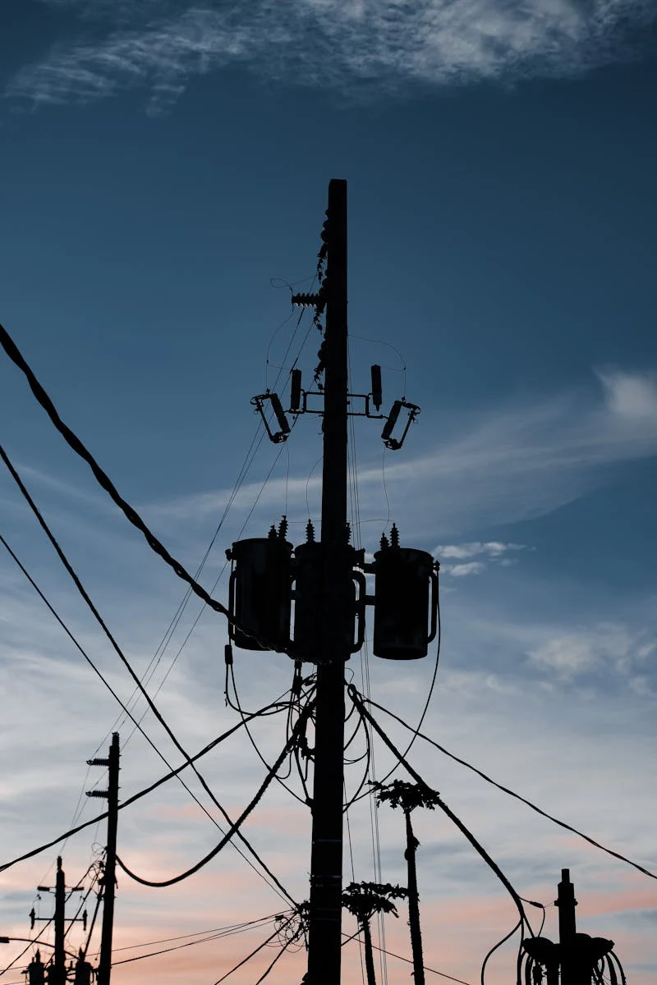
26
Modeling
Development and refinement of the AI model
●
Initial attempts using Logistic Regression and Random Forest models yielded a validation accuracy of only 51%, indicating limitations
●
Labeling issues within the dataset negatively impacted the performance of the Random Forest model, leading to suboptimal results
●
The final approach adopted a Convolutional Neural Network (CNN),, leveraging Google Colab for enhanced computational resources
●
The CNN model achieved a high accuracy rate of 94%, demonstrating its effectiveness in real- time inference for leaf images

Slide 28

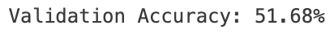
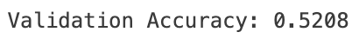
27

